Slide 1
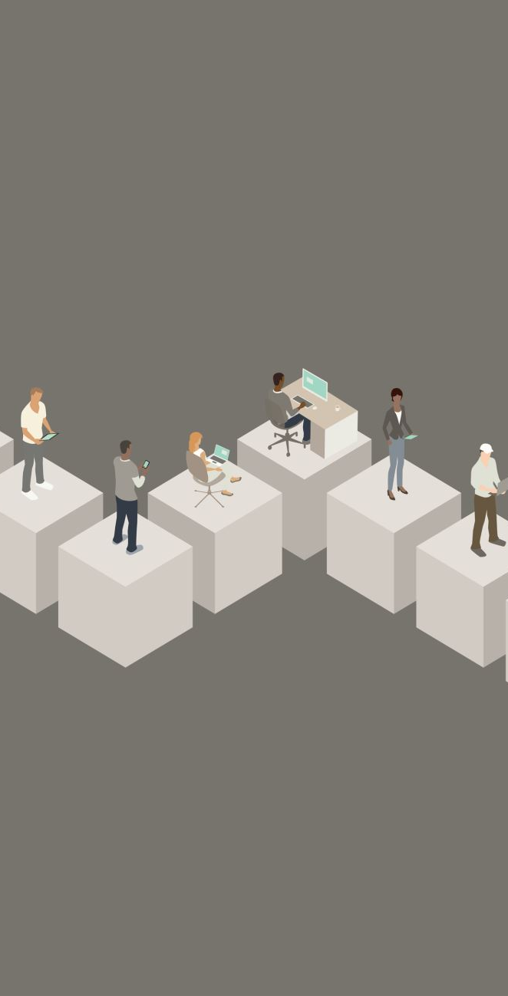
Object Oriented Discrete-Event CS 4632
Department of Computer Science
College of Computing and Software Engineering
Kennesaw State University

Slide 2
Simulation Model
Built from the conceptual model of a system.
Implemented in an appropriate programming or simulation language.
Is needed to mimic the behavior of the real system under certain constraints.

Slide 3
Development of Simulation Models
Two main objectives:
To study some relevant aspects in the dynamic behavior of a system
To estimate various performance measures of the system

Slide 4

Simulation Run
A simulation run is an experiment carried out for some observation period using the simulation model to study (predict) the behavior of the system.

Slide 5
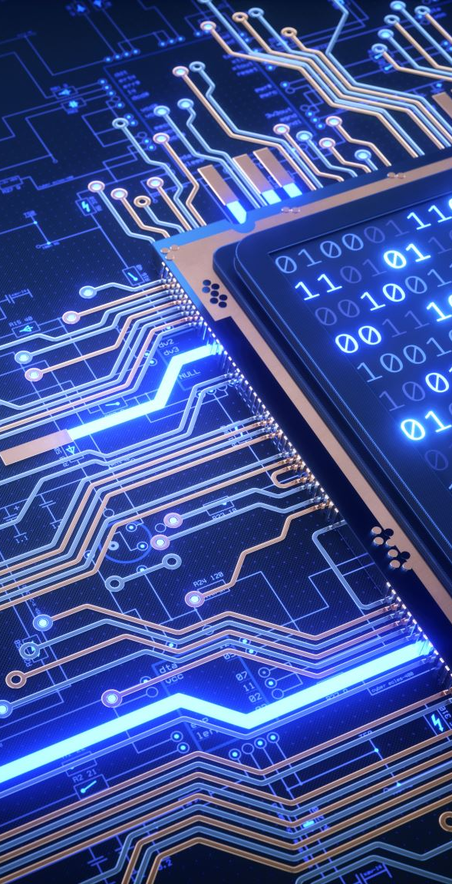
Simulation Language
The advantages and disadvantages of an object-oriented simulation programming language compared to an integrated icon-based simulation tool are:
Flexibility and
Power of the simulation language
May be more difficult to use than an integrated simulation tool.

Slide 6
Using A Simulation Model
A user must be allowed to:
Manipulate the model by supplying it with a set of inputs
Observe its behavior or output
Predict the behavior of the real system by analyzing the behavior of the model

Slide 7
Supporting Software
The simulation executive. The program that controls every simulation.
The set of utility functions for housekeeping tasks.
Reporting simulation trace and output statistics

Slide 8
Facilities Provided by Simulation Software
Maintain the sequence of event records (pairs of event and event time)
Provide mechanisms for the generation and cancellation of event records
Maintain the simulation clock
Provide functions to generate random numbers from common probability distributions

Slide 9
The Time Dimension
Simulation time, the time referenced by executing simulation models. This time is advanced by:
Fixed time increments
Variable time increments (event scan)
Run time, the absolute time referenced by the OS while a program executes.

Slide 10

World View with Discrete-Event Simulation
Event approach
Activity approach
Process interaction approach

Slide 11
The Process Interaction
A simulation model consists of a description of how processes (active entities) are going to interact among themselves, as time passes.
Also includes a description of passive objects
A simulation run consists of creating and starting the processes interacting among themselves, synchronizing and using resources.

Slide 12
Process View
Static Process Description
Dynamic Process Management
Initiate Process
Delay (Time) Process
Suspend Process
Activate Process
Terminate Process

Slide 13
Resource View
Standard/Tailored Resource Handler
Resource Management
Create resource
Request resource
Acquire resource
Release resource
Status of resource
Destroy resource

Slide 14
Simulation Executive
Schedule processes at particular instants, i.e., place processes in the event list
Remove processes from the event list ( to make them idle or to terminate them)
Re-schedule processes, i.e., change position of processes in the event list.
Execute the “running” process.

Slide 15
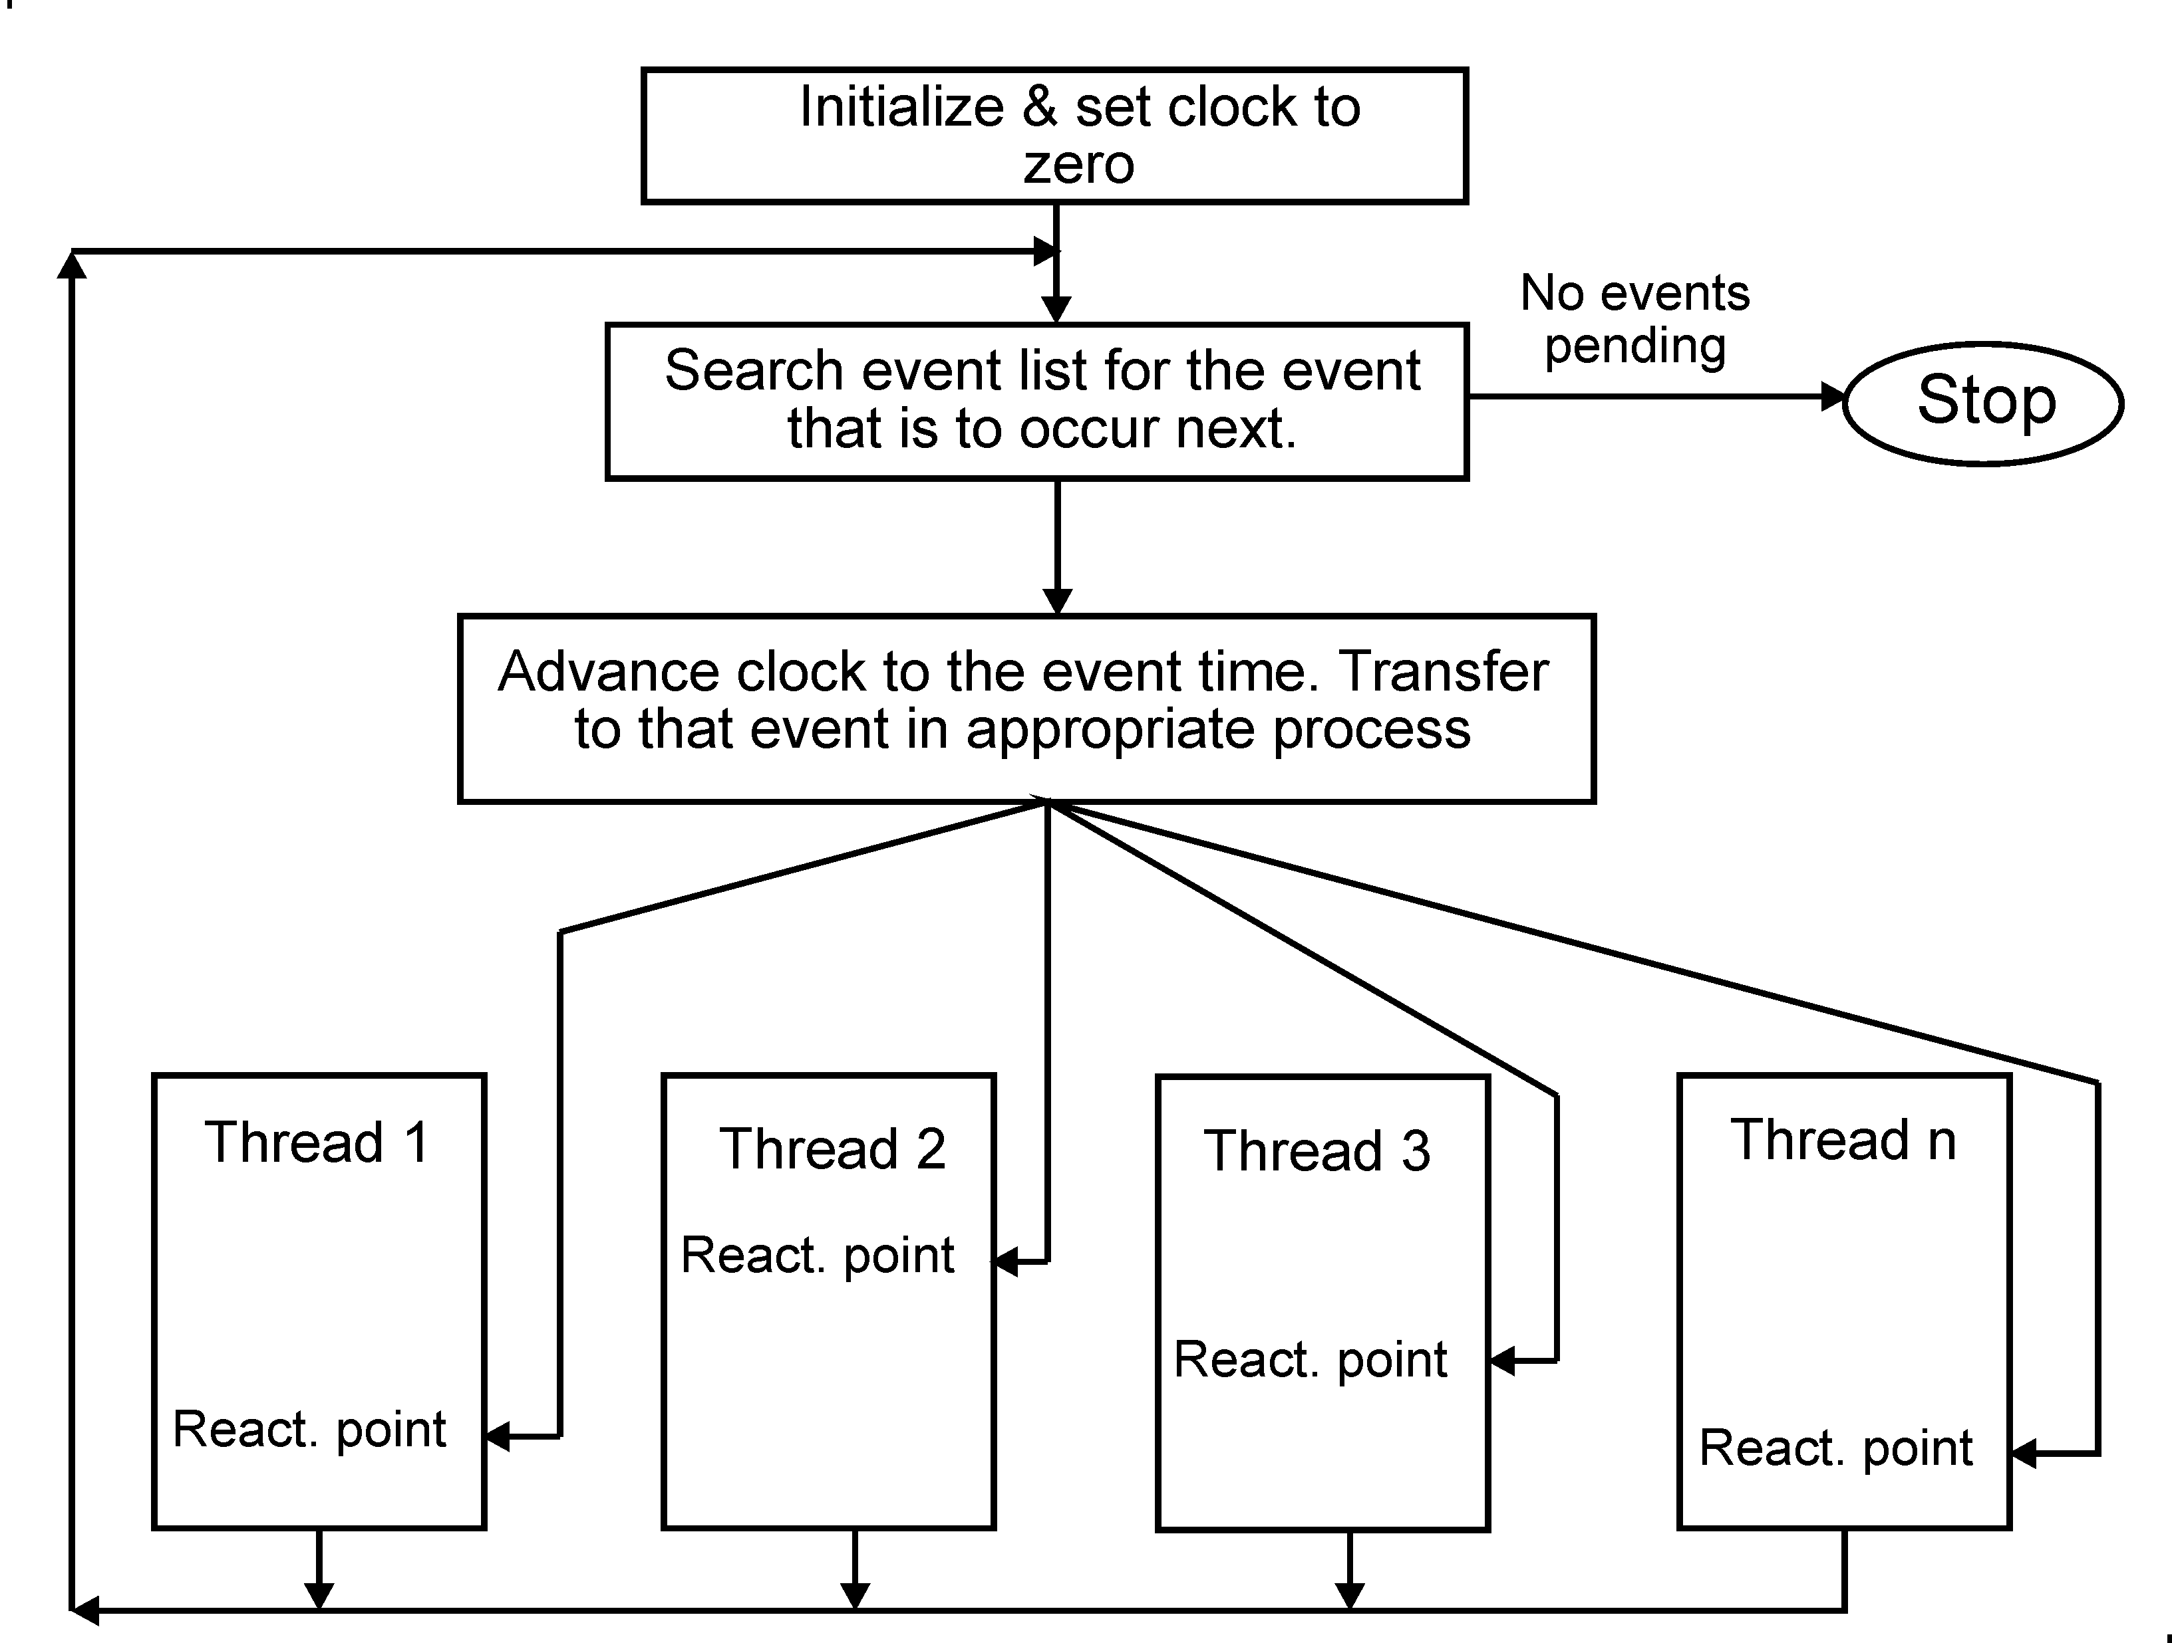
The Simulation Executive

Slide 16
Overview - Levels of Abstraction
16
In modeling a system, different levels of abstraction are used to describe the system
The most abstract level is at the top (high), and it is the easiest to understand
The most difficult level of abstraction is the implementation level, i.e., the programming of the model into a suitable simulation programming language.

Slide 17
Process Interaction Simulation
The major components in a model are active and passive entities
The active entities are called processes and have a life of their own
The passive entities are resources and queues
The processes interact among themselves and use resources

Slide 18
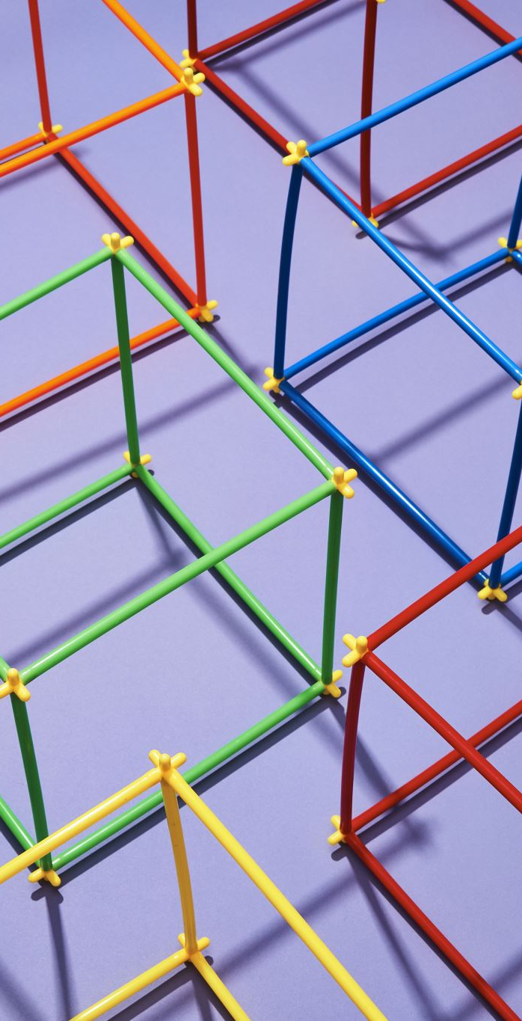
Queuing Models
Models that include at least one queue
The queue is a data structure that stores waiting customers
The server removes from the queue the next customer to service

Slide 19

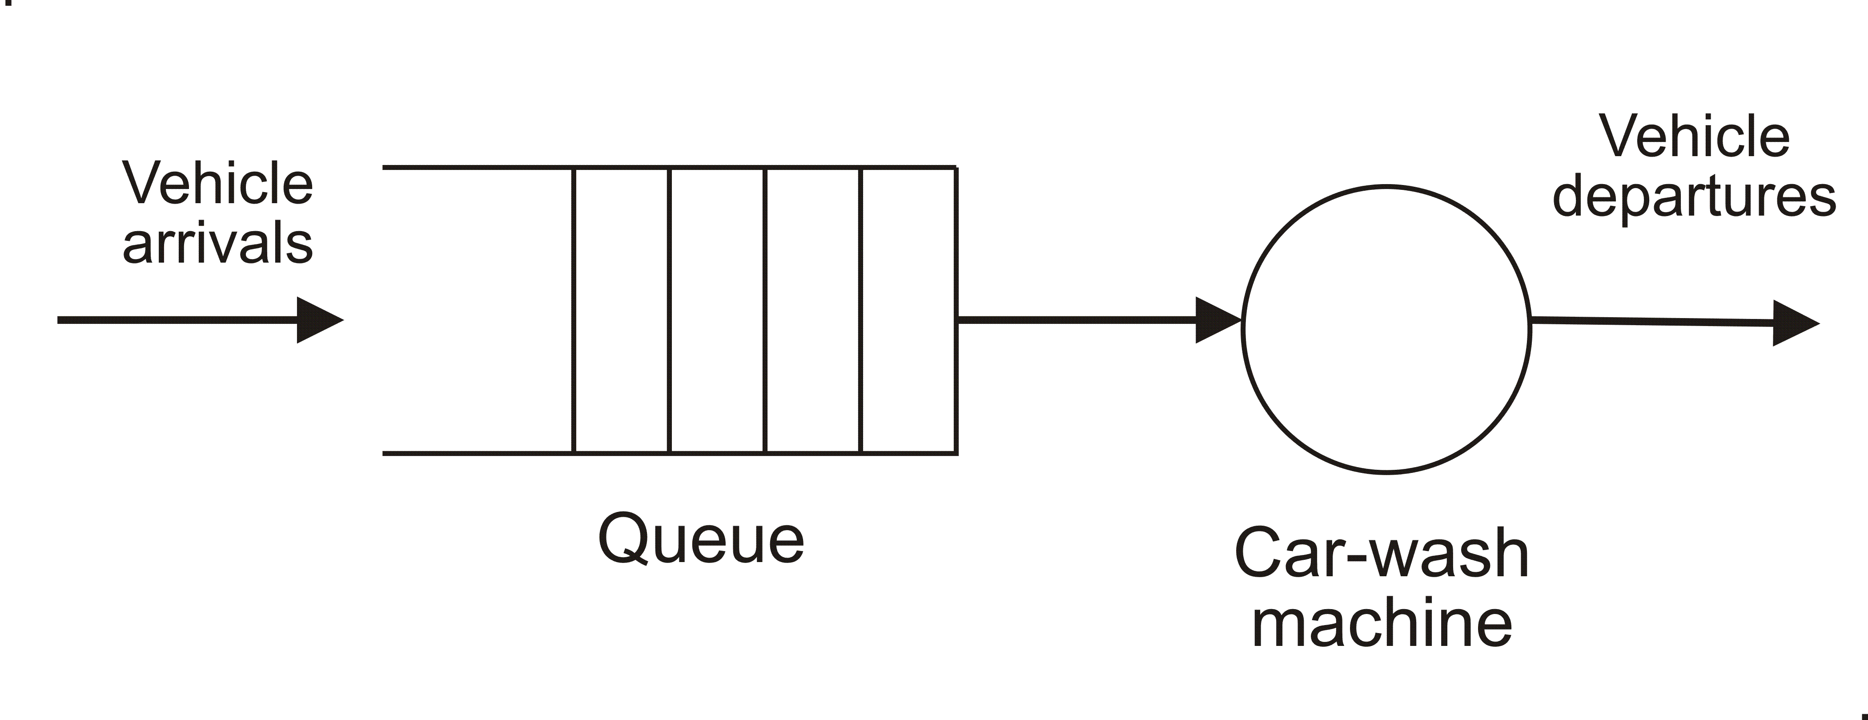
Carwash Model – Single-server
Vehicle Arrivals: Vehicles enter the system randomly and are placed in a queue if the carwash machine is currently busy.
Queue: The queue holds vehicles in line, waiting for their turn to be washed. The queue length can vary depending on the arrival rate of vehicles and the service rate of the carwash machine.
Carwash Machine (Single Server): This is the processing unit in the system, serving vehicles one at a time. The time it takes to wash each vehicle is considered the service time.
Vehicle Departures: After being serviced by the carwash machine, vehicles leave the system.

Slide 20

Basic Categories of Queuing Models
Single-server models
Multi-server models
Queuing networks
Multi-server, multi-queue with priorities
Multi-server, multi-queue with priorities and preemption.

Slide 21
Examples of Queuing Models
Computer systems
Communication systems, networks
Teller facilities in a bank
Production systems
Transport and materials handling
Repair and maintenance systems

Slide 22
Service Stations
A queuing model consists of a number of facilities and interconnecting queues. Each facility, or service station, consists of one or more servers.
For these types of systems, it is very common in practice to use exponentially distribution for inter-arrival periods and for service periods.

Slide 23

Multiple Servers Single Queue
Any of the servers available can provide service demanded by a customer
A server removes the next customer from the head of the customer queue
One or more servers can be idle, waiting for customers to arrive

Slide 24
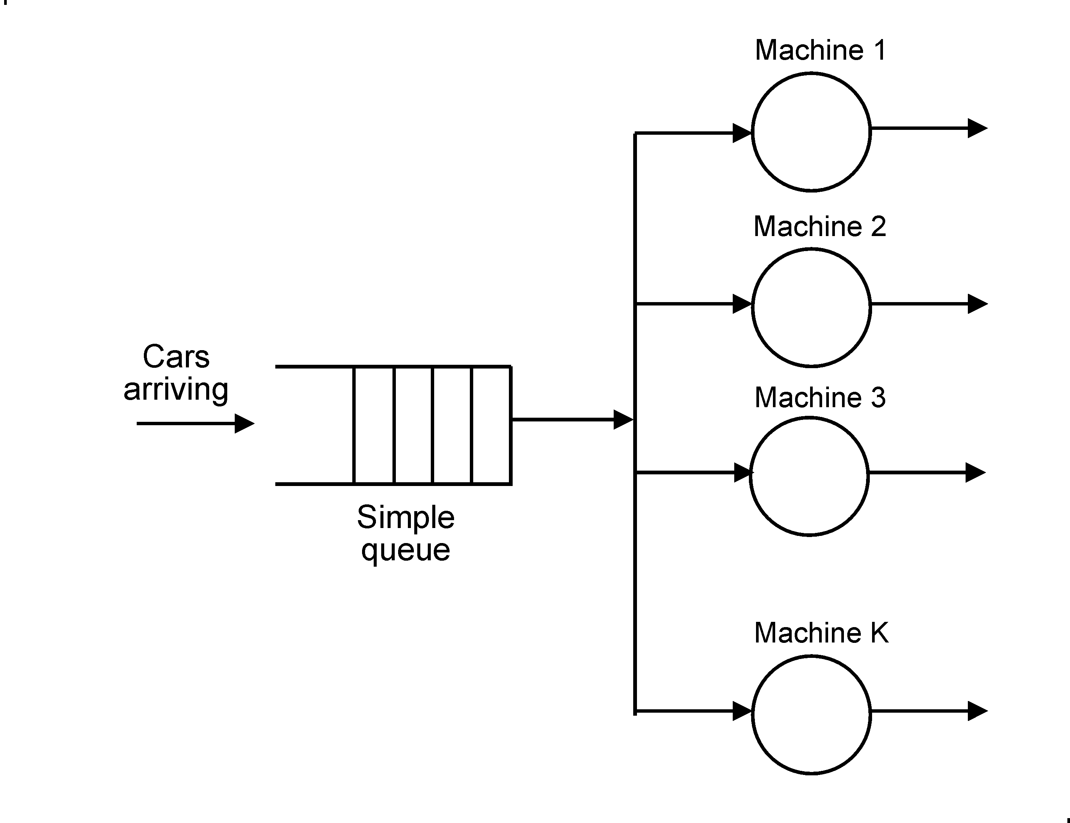

Carwash Model With Multiple Machines

Slide 25
General Description of the Model
This model has K machines (servers)
A customer can receive service from any machine (any server)
A customer waits in the customer queue until it is at the head of the queue and a machine becomes available
The machine removes the customer from the head of the queue and starts to service it

Slide 26
Idle Servers
Idle servers are organized in a server queue
A server joins a queue of idle servers if there are no customers
An arriving customer enters the input queue and reactivates the server at the head of the server queue. If there are no servers available, the customer just waits

Slide 27
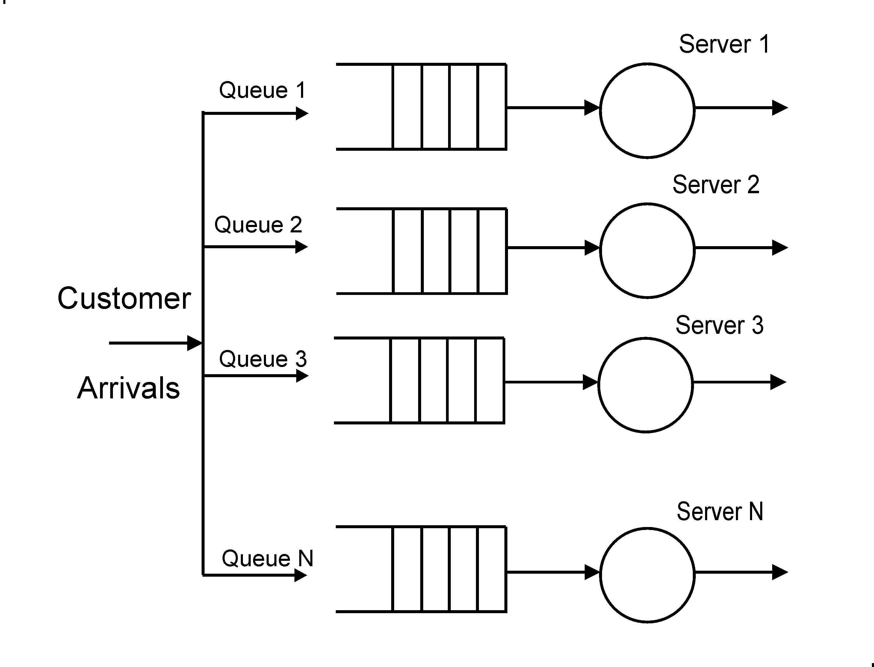
Models With Multiple Servers and Multiple Queues

Slide 28
Multi-Server Multi-Queue Model
Every server has its own queue of customers
An arriving customer selects the server with the smallest queue
Alternatively, an arriving customer randomly selects a server.

Slide 29
Multi-Server Multi-Queue Model with Preemption
Every customer has a priority
An arriving customer can interrupt the service of another customer with a lower priority
the interrupted customer is returned to its queue, this customer is the one with the lowest priority and that started most recently.
29

Slide 30
Performance Measures
The average number of customers in the system
The average number of customers in the queue(s) (i.e., that are waiting)
The average time that a customer spends in the system
The average time that a customer spends in the customer queue waiting
The server(s) utilization

Slide 31
Queuing Networks
Consists of two or more interconnected stations
Each station provides a different service
The output from a station are connected to input of another station
Each station has one or more servers and its queues

Slide 32
Service in a Queuing Network
Customers enter the network at any of several entry stations
Customers are routed through the network demanding service from different stations
Customers can exit from any of several exit stations

Slide 33
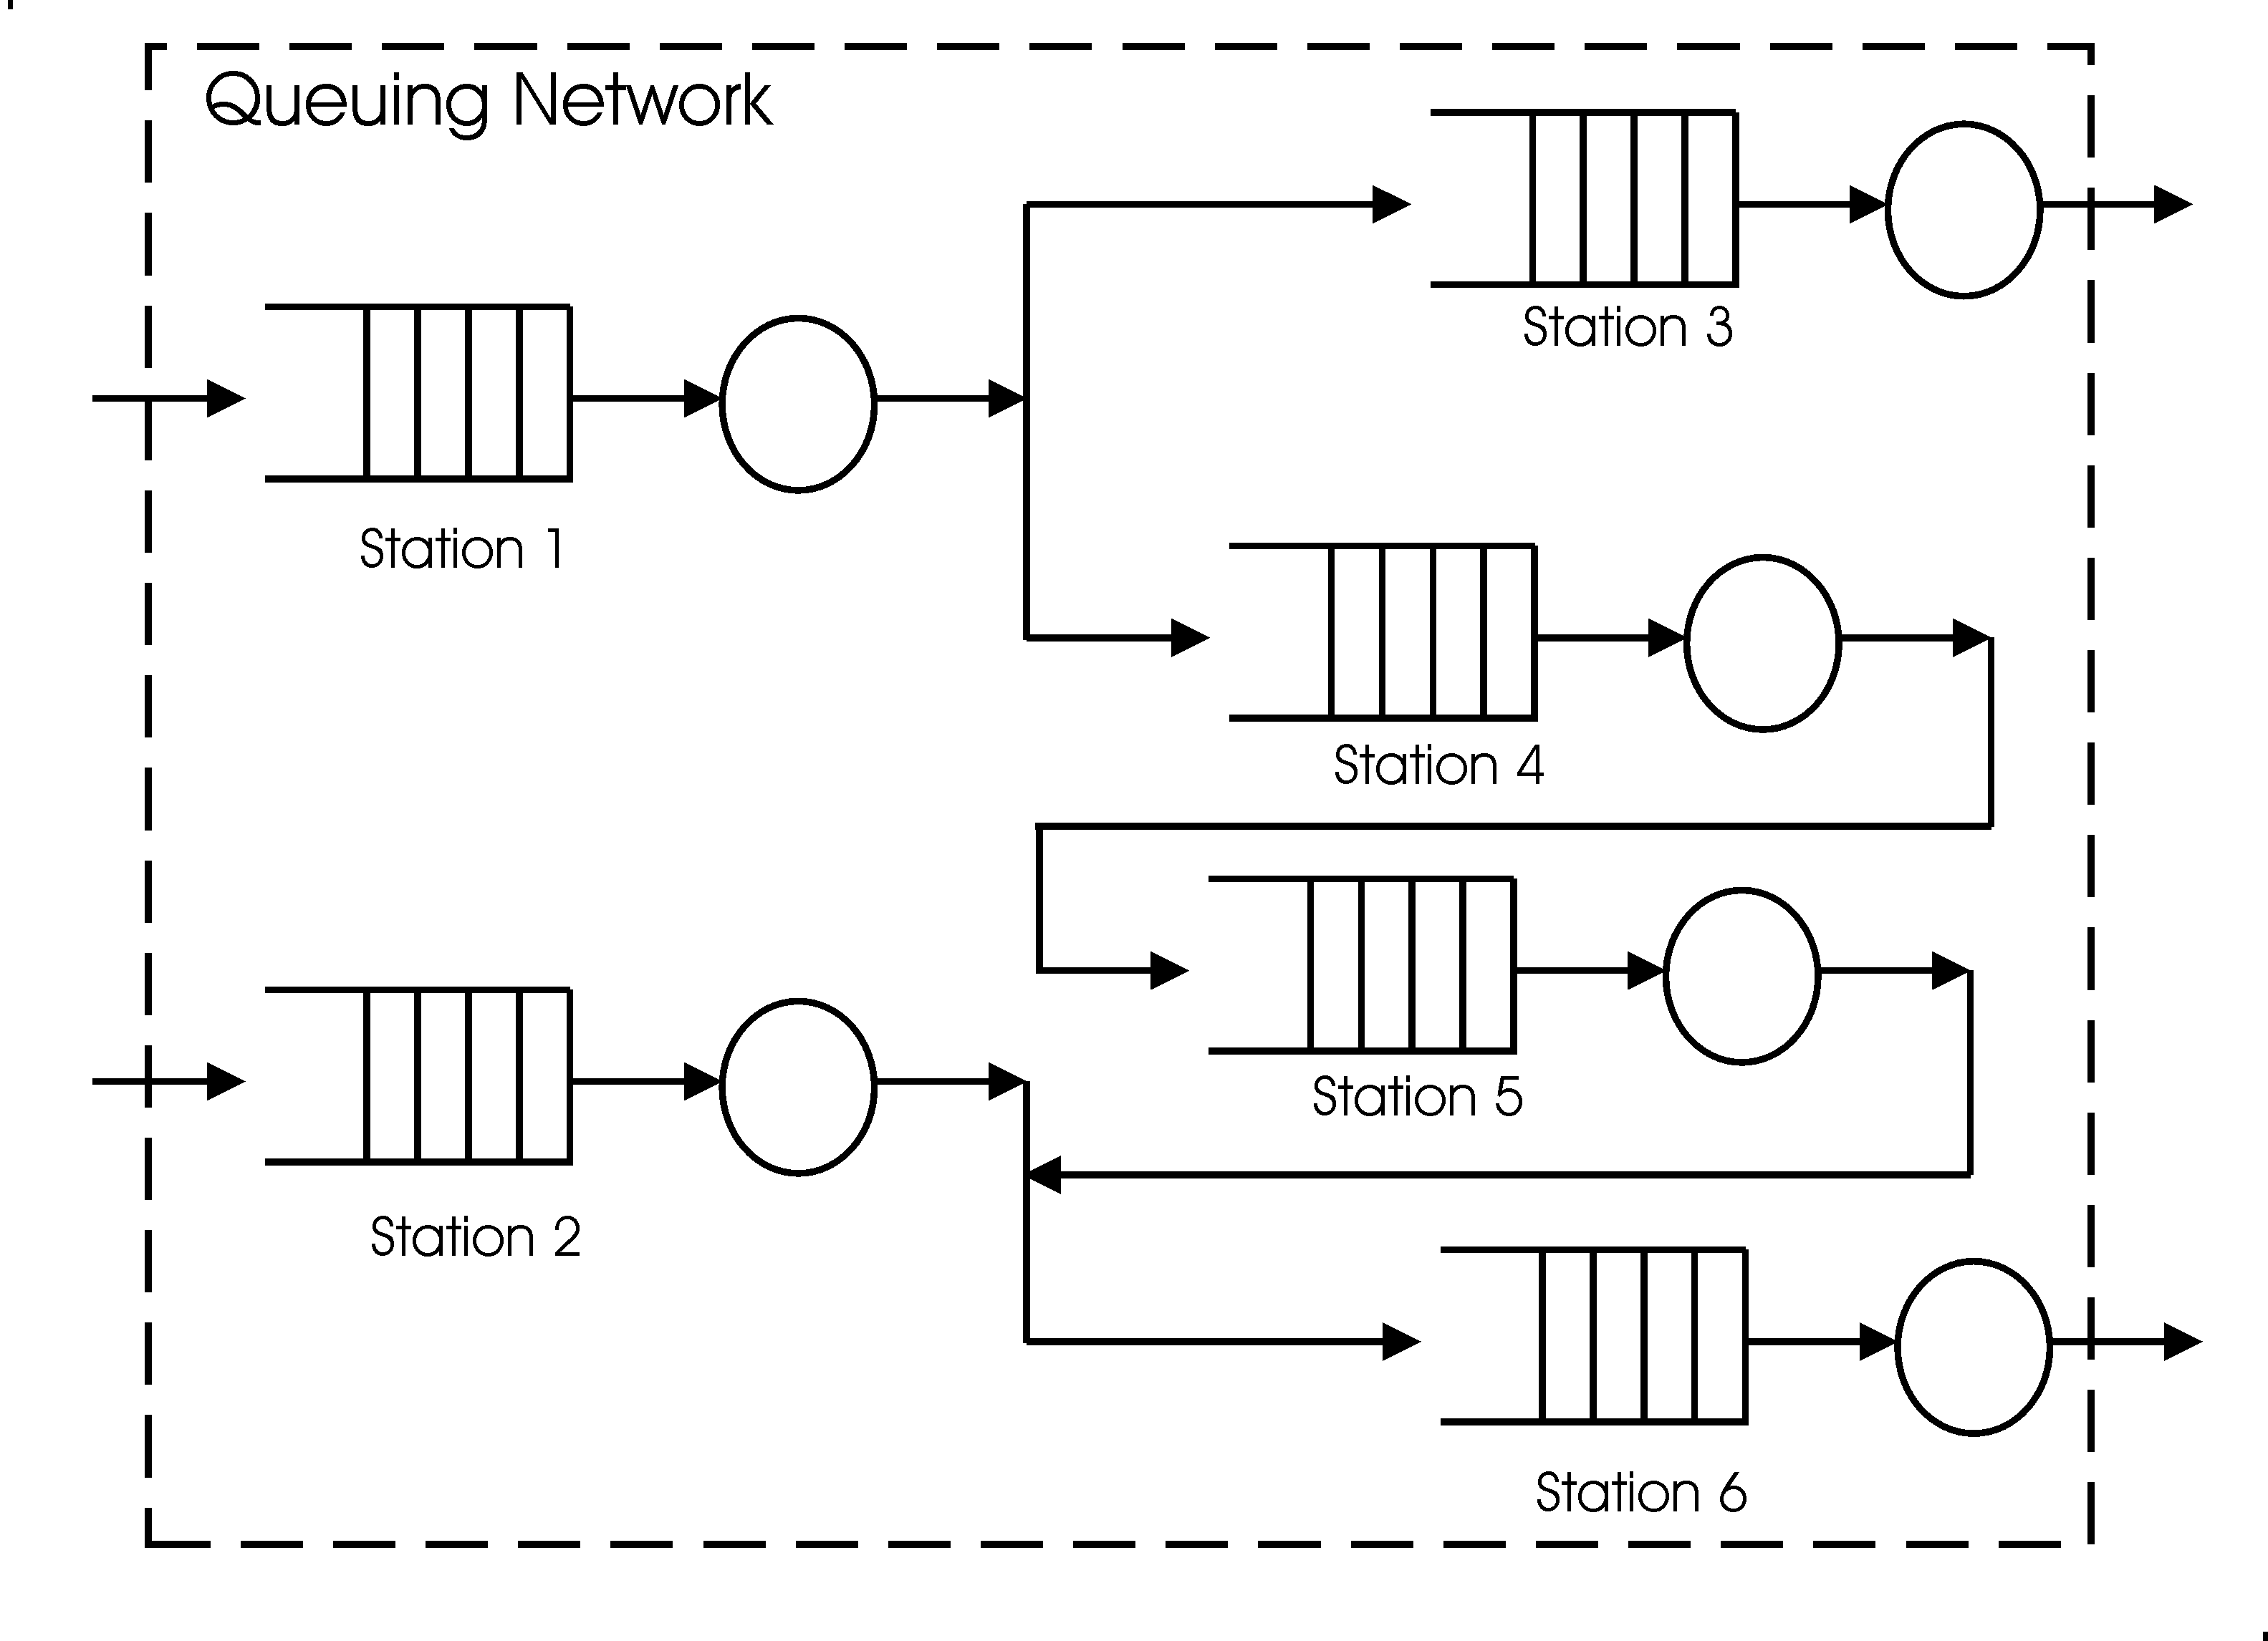
A Queuing Network

